Slide 1
Summary
Studyforrest_dFC

Slide 2
Data description
Data were collected from the studyforrest project (studyforrest.org)
15 Participants were scanned using MRI while watching the entirety of the movie Forrest Gump
fMRI activity were collected across the whole movie in 8 runs, in intervals (i.e. TRs) of 2 seconds
dFC was calculated by taking a window of activity divided equally around the time point of interest, and then correlating the activity in this window amongst the 419 ROIs as delineated in Schaefer2018.
ROI activity was simply the amplitude of the BOLD signal for each of the 419 ROIs at the corresponding timepoint (i.e. TR) of interest.

Slide 3
Question and Aim
Does the pattern of connectivity between different brain regions, or the simple pattern of neural activity of brain regions, be better representative of movie scenes?
Connectivity measures how related patterns of activities are, not the magnitude of activity per se.
Compare dynamic functional connectivity (dFC) against the pattern of BOLD activity at each ROI.

Slide 4
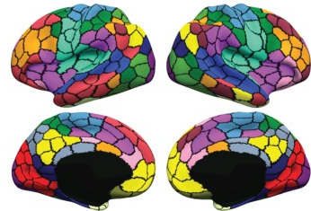
ROI delineation
The human brain divided into 419 regions of interest (ROI). Figure adapted from Schaefer2018.
The neural activity within each ROI changes across time, and can be measured using MRI.
Functional Connectivity (FC) correlates the activity of each ROI across time in a pairwise fashion with remaining ROIs, resulting in a 87,571 (lower-half of a 419-by-419 correlation matrix) unique correlations.

Slide 5
Overview of comparison flow
dFCs vectorised by TR (2,956-by-87,517)
PCA
(2,956-by-10)
Train/test split
(80% train)
SMOTE (Train)
XGBoost (Train)
Test
(20% test)
ROI Timeseries by TR
(2,956-by-419)
Data were transformed/normalised and averaged across subjects.

Slide 6
dFC data preperation
Generated dFCs using a 55 TR (110s) window, and averaged across subjects (total 3,167 TRs across 8 runs)
Vectorised dFCs per TR into rows (i.e. created matrix of 3,167 rows by 87,571 columns)
Labelled each dFC window with the scene according to the timestamp.
Dropped rows according to the criteria below, resulting in a 2,956-by-87,571 matrix (87,572 with labels):
Scenes that were not consistent across the TR
Scenes occurred less than 10 TRs in total across all runs
Performed PCA on the 2,956-by-87,571 matrix (excluding labels), selected the first 10 PCs
10 PCs were selected based on repeated testing of varying number of PCs, to find the least number of PCs where accuracy and F1 scores stabilised
Final Feature matrix: 2,956 vectorised dFC windows by 10 PCs
Target vector: 2,956 scene labels
Notes:
Synthetic Minority Over-sampling Technique

Slide 7
Selection of 10 PCs

Slide 8
ROI activity data preparation
Generated averaged (standardised) timeseries of each ROI by TR across subjects (total 3,167 TRs across 8 runs)
Labelled data similarly to the dFC matrix, but DID NOT perform PCA.
Final Feature matrix: 2,956 dFC windows by 419 ROIs
Target vector: 2,956 scene labels
Notes:
Synthetic Minority Over-sampling Technique

Slide 9
Common workflow
Features were randomly split into 80% train and 20% test matrices, stratified by target vector.
Synthetic data for minority classes in the Training dataset were generated using SMOTE (k neighbours = 5)
Model was trained using XGBoost, and tested on the remaining 20%.
Classification accuracy, precision and recall scores were measured.
This train/test workflow was repeated 50 times.

Slide 10
Results
Notes:
Macro: Calculate metrics for each label, and find their unweighted mean. This does not take label imbalance into account.
Accuracy = (TP + TN) / Total
Precision = TP / (TP + FP)
Recall = TP / (TP + FN)

Slide 11
PC plots
For each PC, the weights of each ROI-to-ROI connection are plotted as a 419-by-419 heatmap, with each ROI further grouped into 9 networks.
The subsequent plots are thresholded to show the top 10%, in terms of absolute weight, of the importance of each connection between ROIs towards each PC.

Slide 12
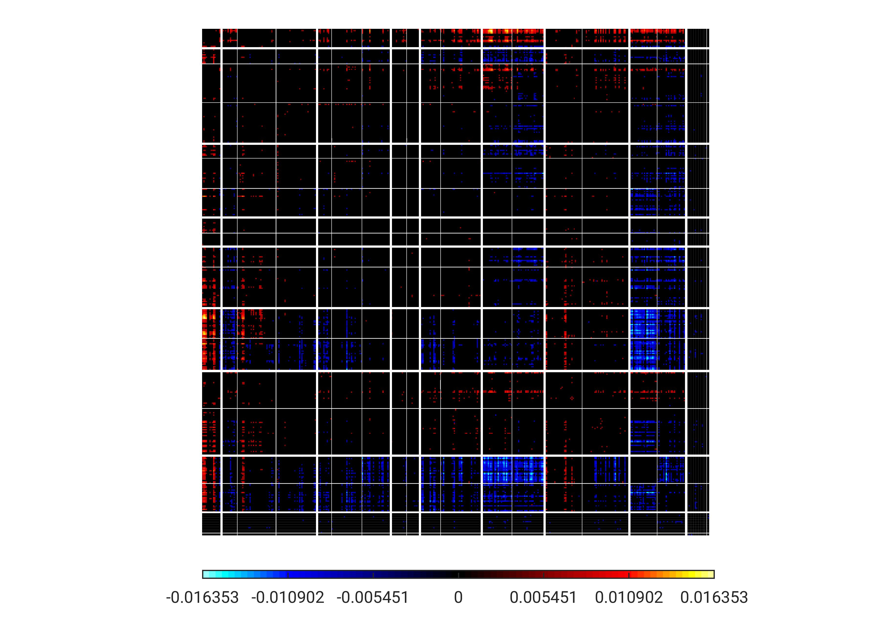
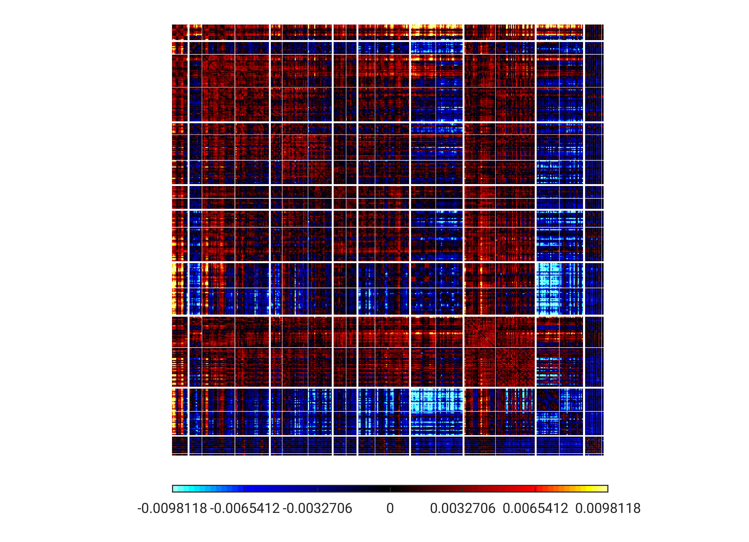
PC1
TempPar
Default
Control
Limbic
Sal/VentAttn
DorsAttn
SomMot
Visual
Subcort

Slide 13
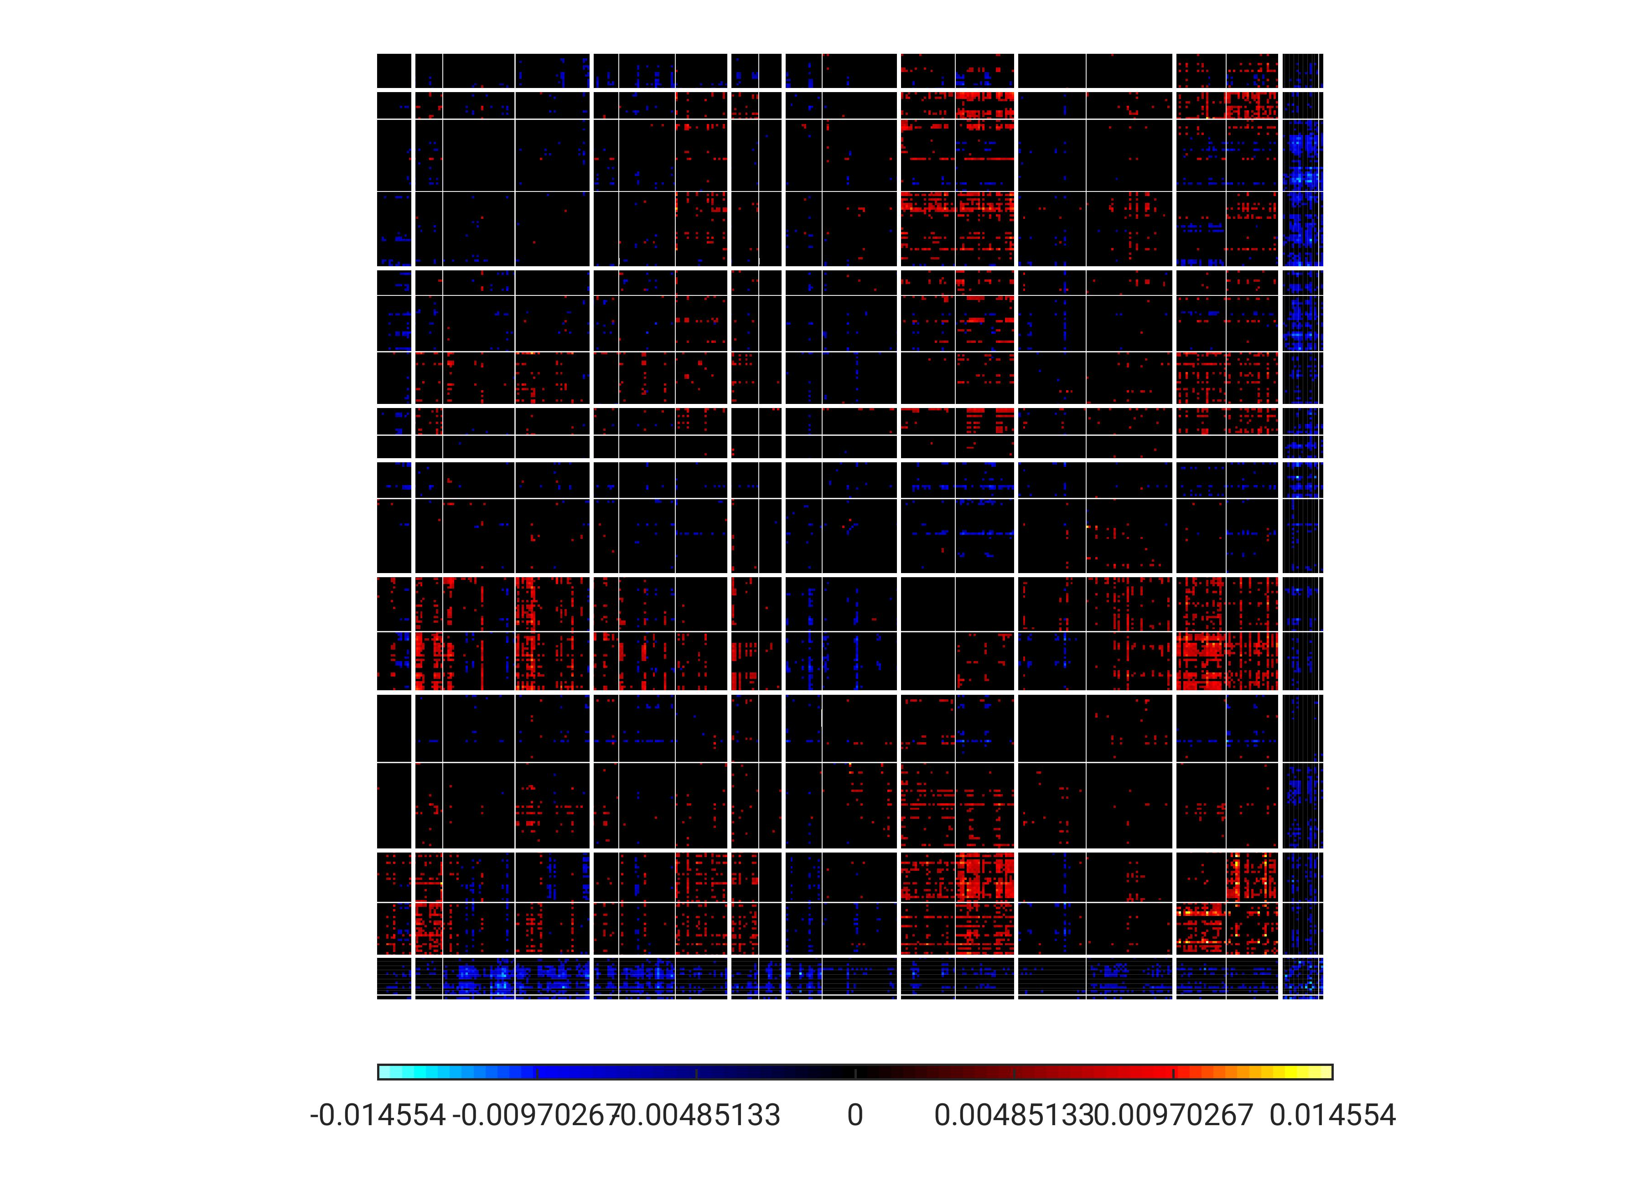
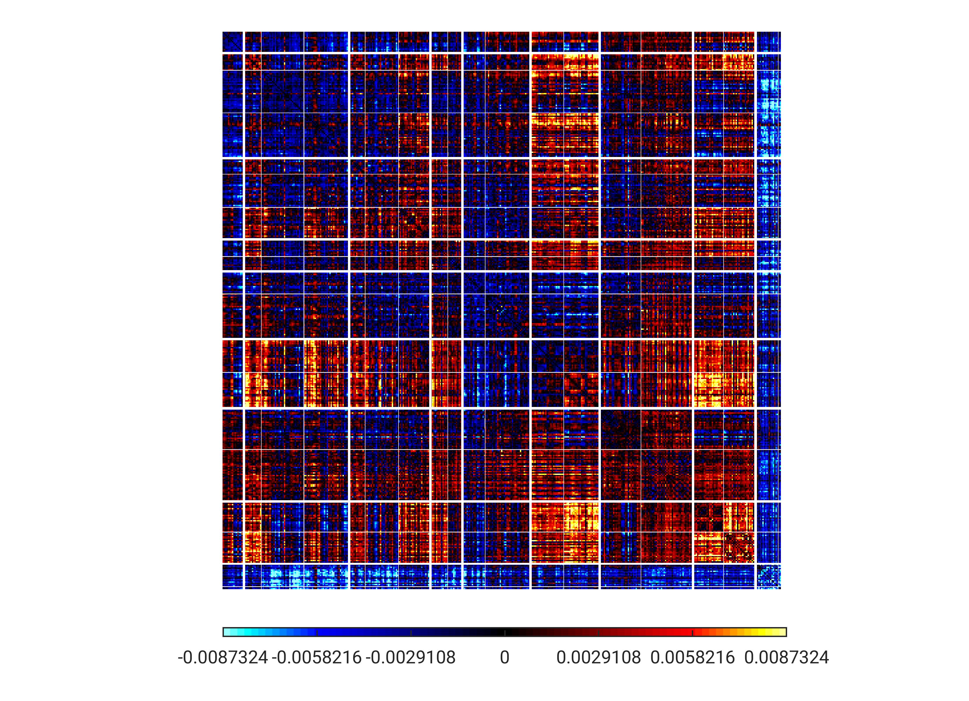
PC2
TempPar
Default
Control
Limbic
Sal/VentAttn
DorsAttn
SomMot
Visual
Subcort

Slide 14
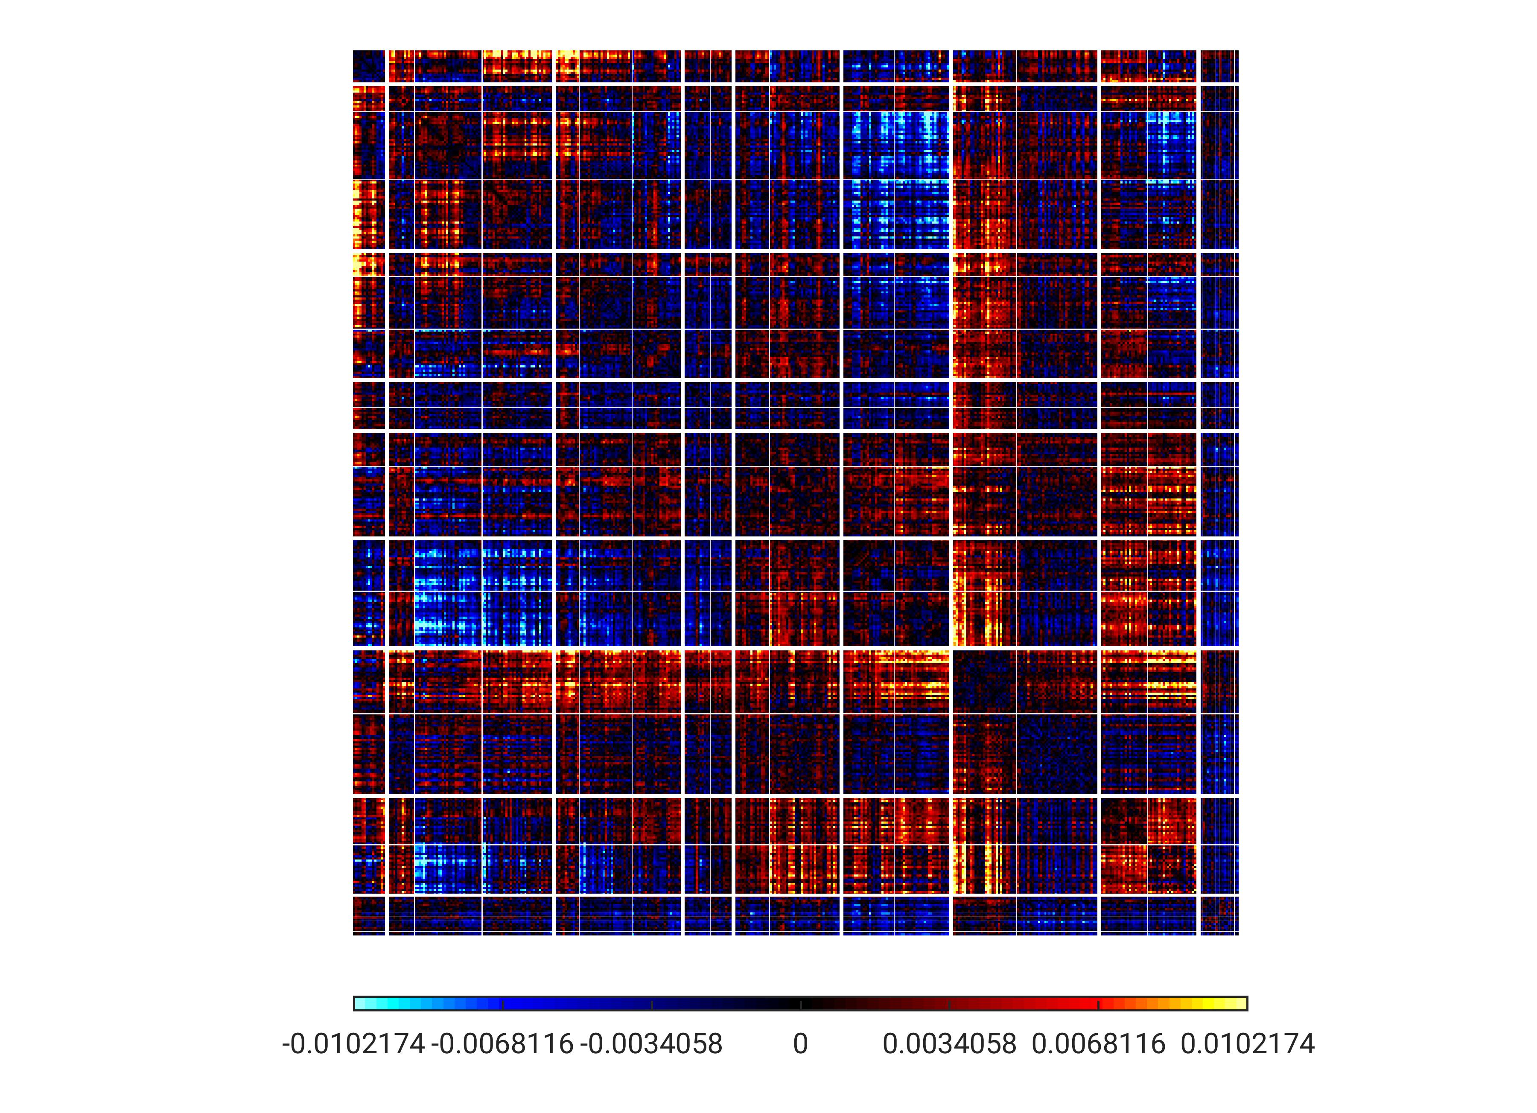
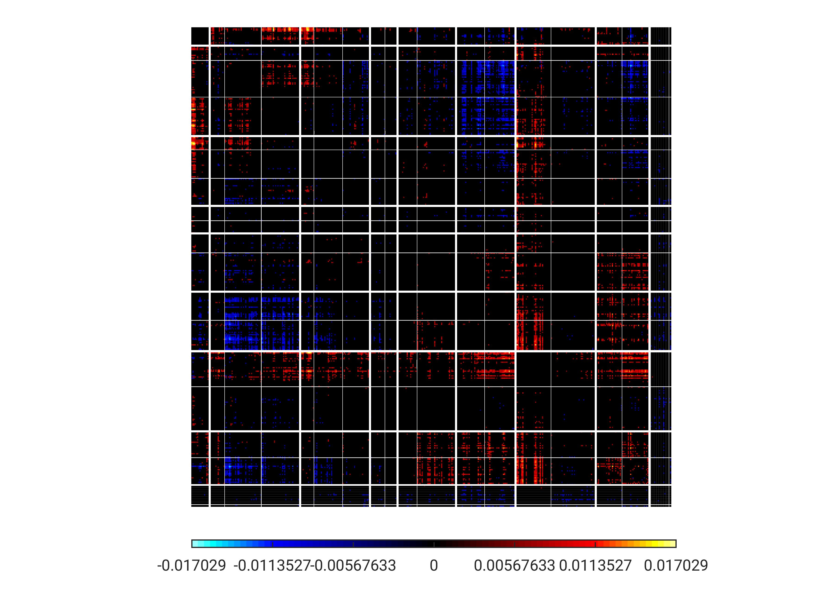
PC3
TempPar
Default
Control
Limbic
Sal/VentAttn
DorsAttn
SomMot
Visual
Subcort

Slide 15
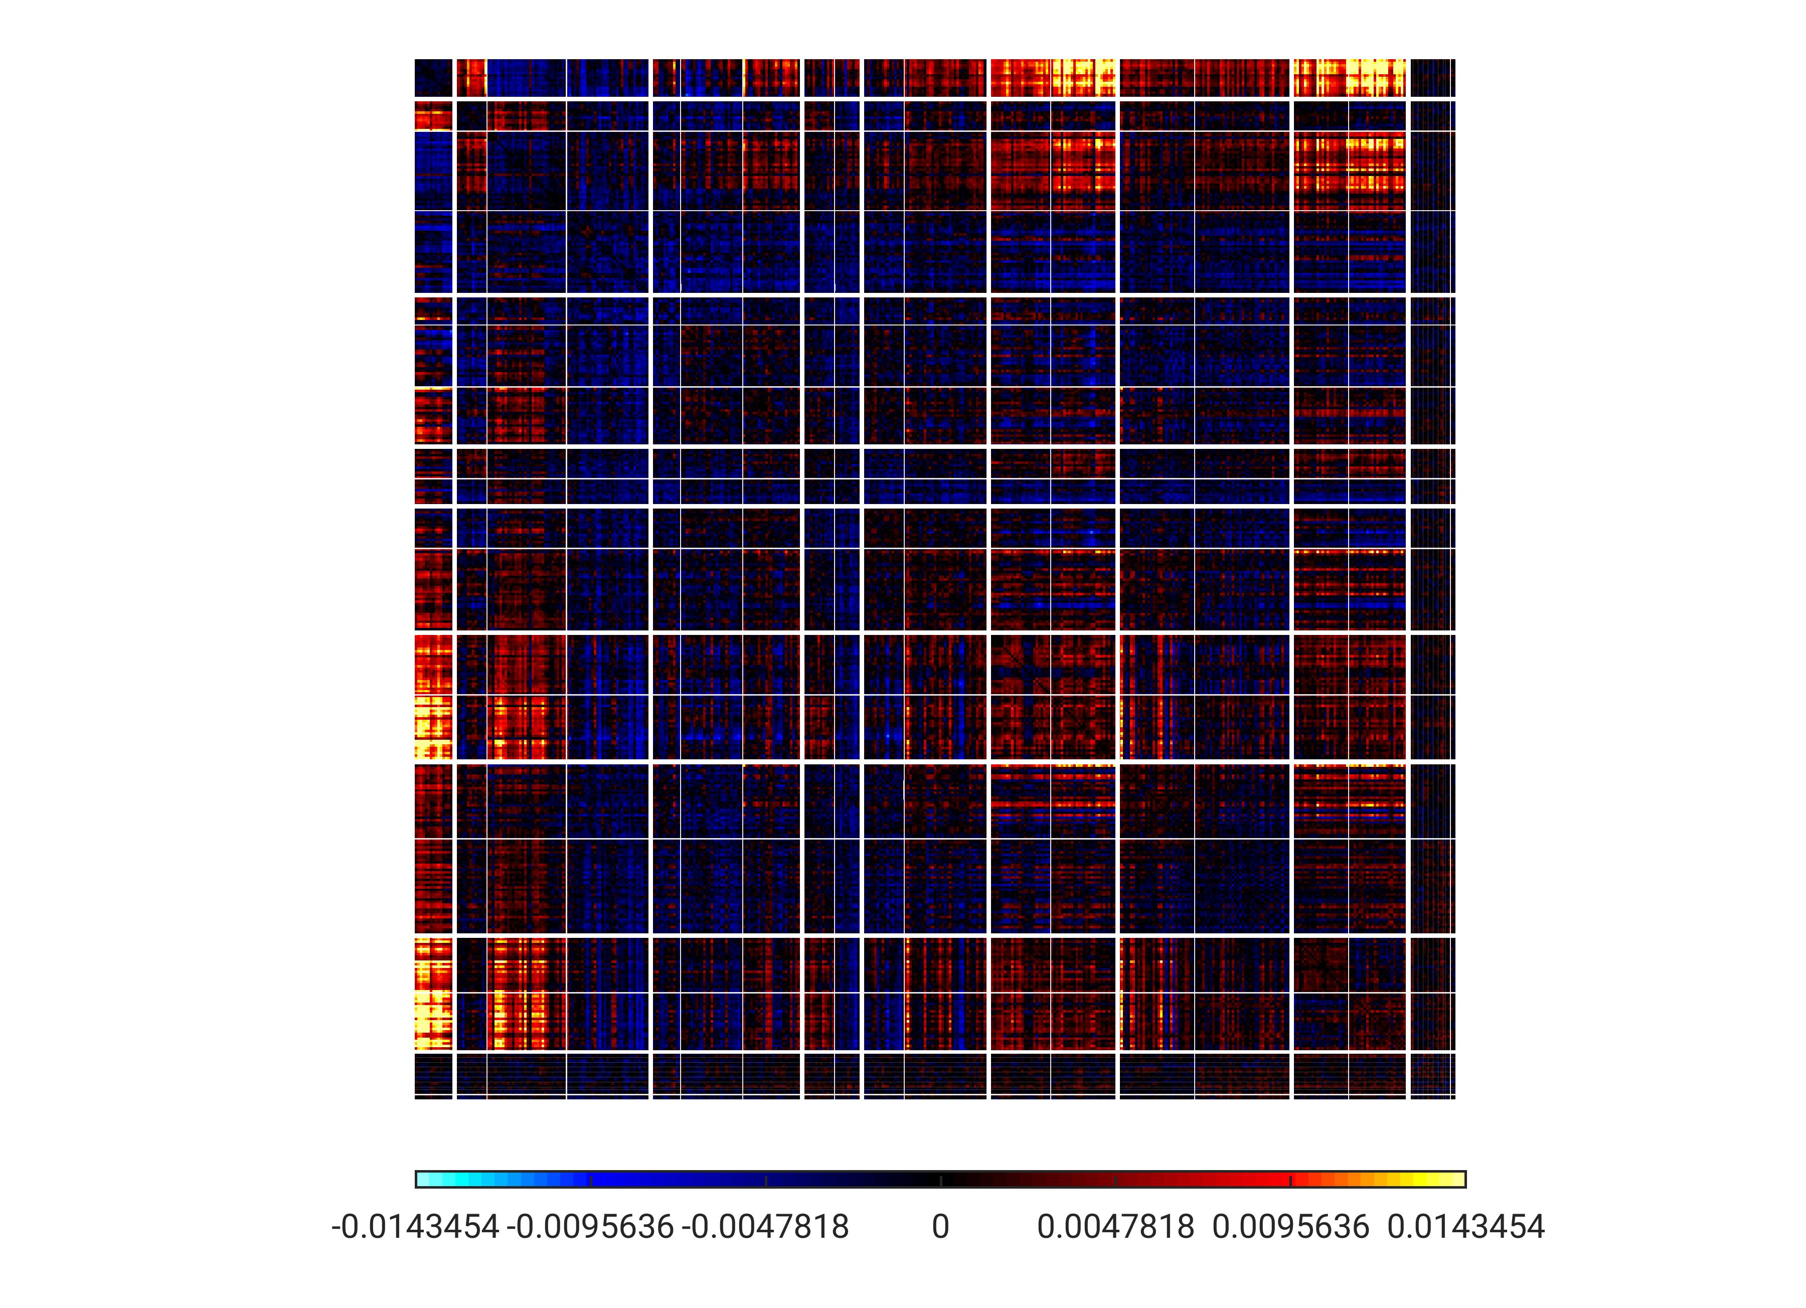
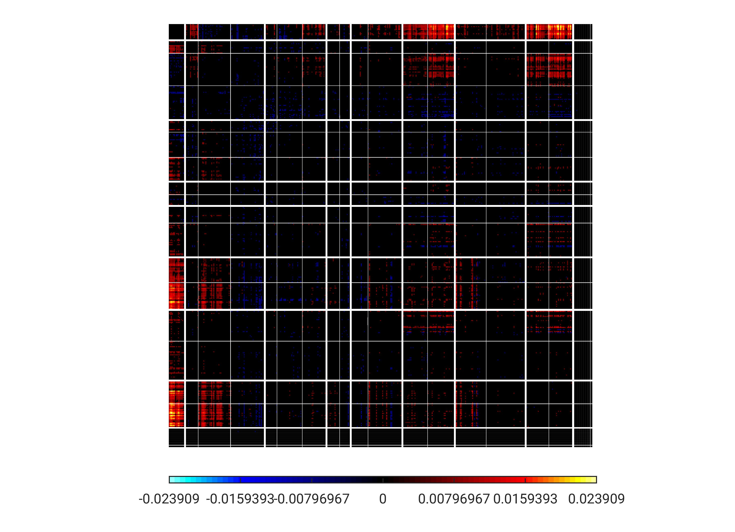
PC4
TempPar
Default
Control
Limbic
Sal/VentAttn
DorsAttn
SomMot
Visual
Subcort

Slide 16
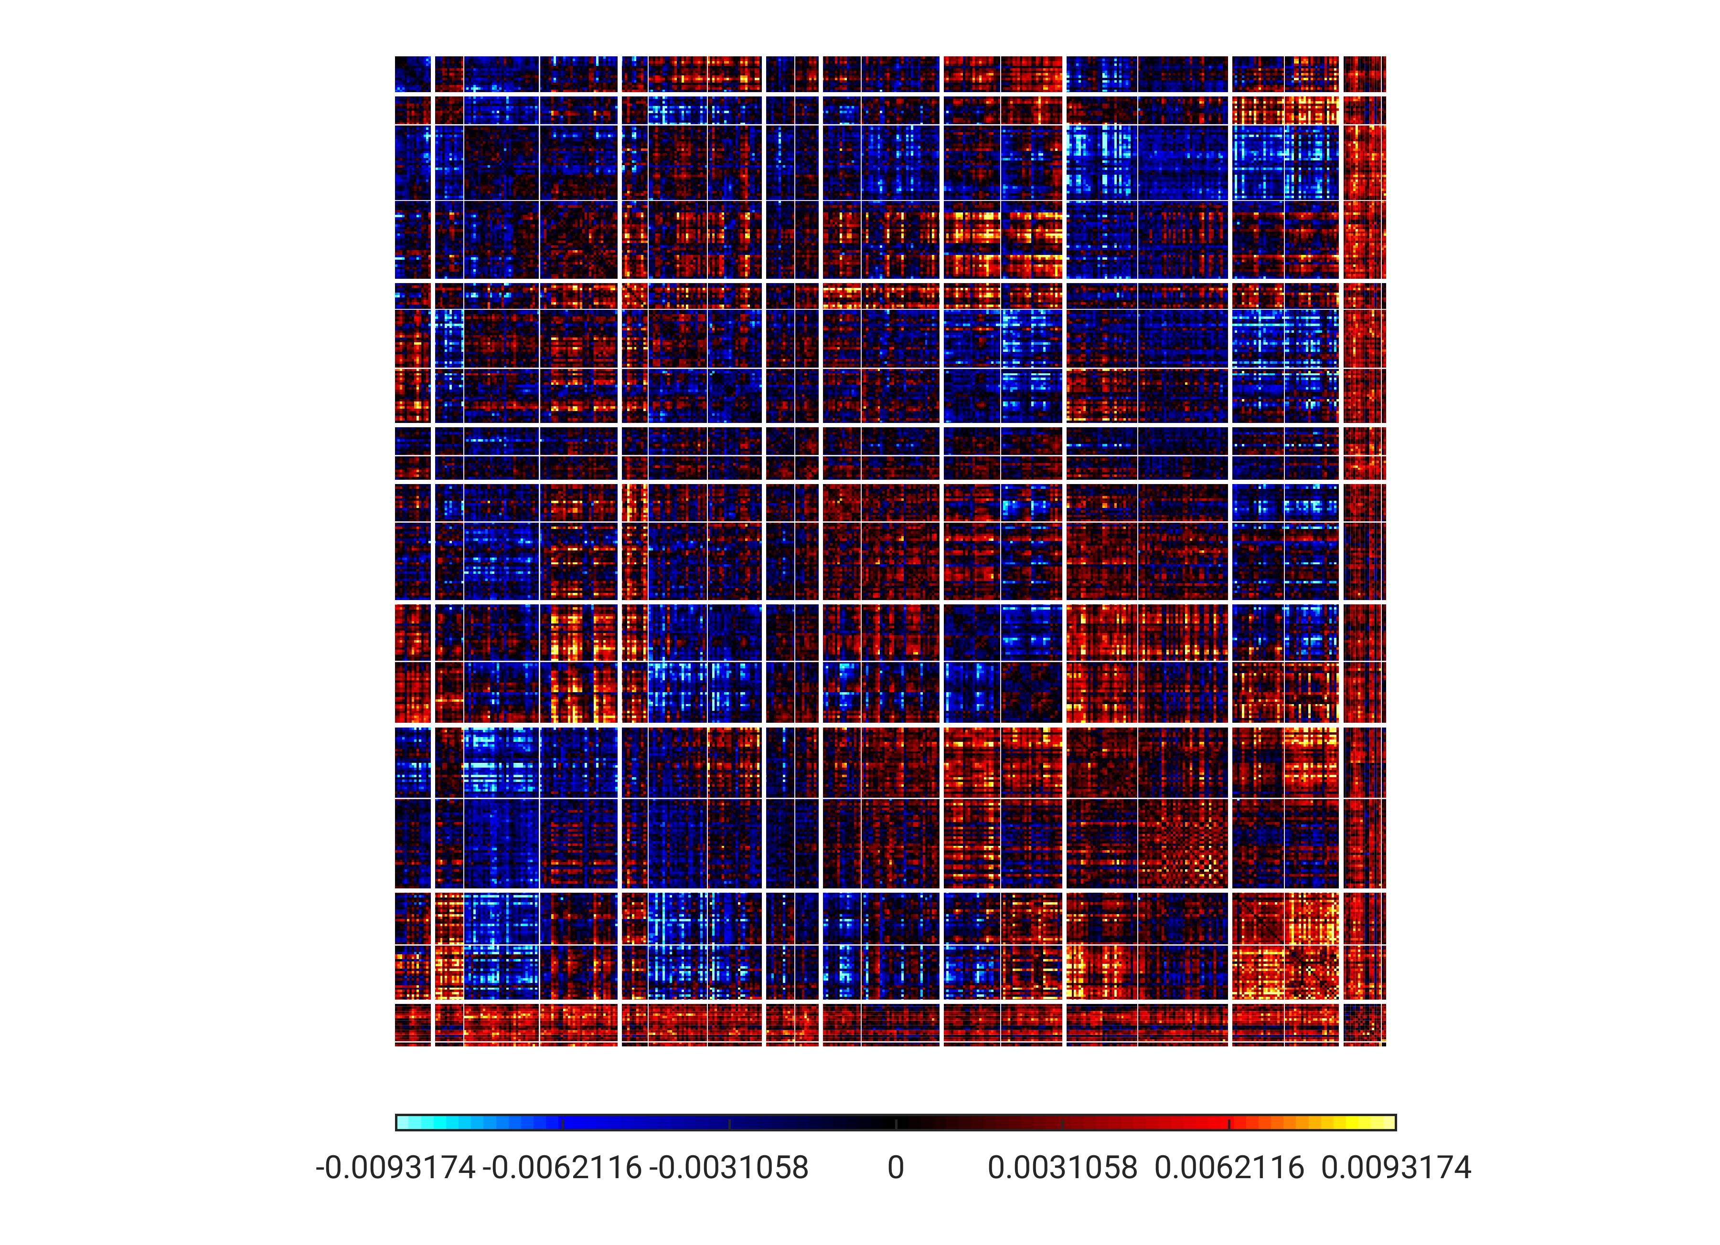
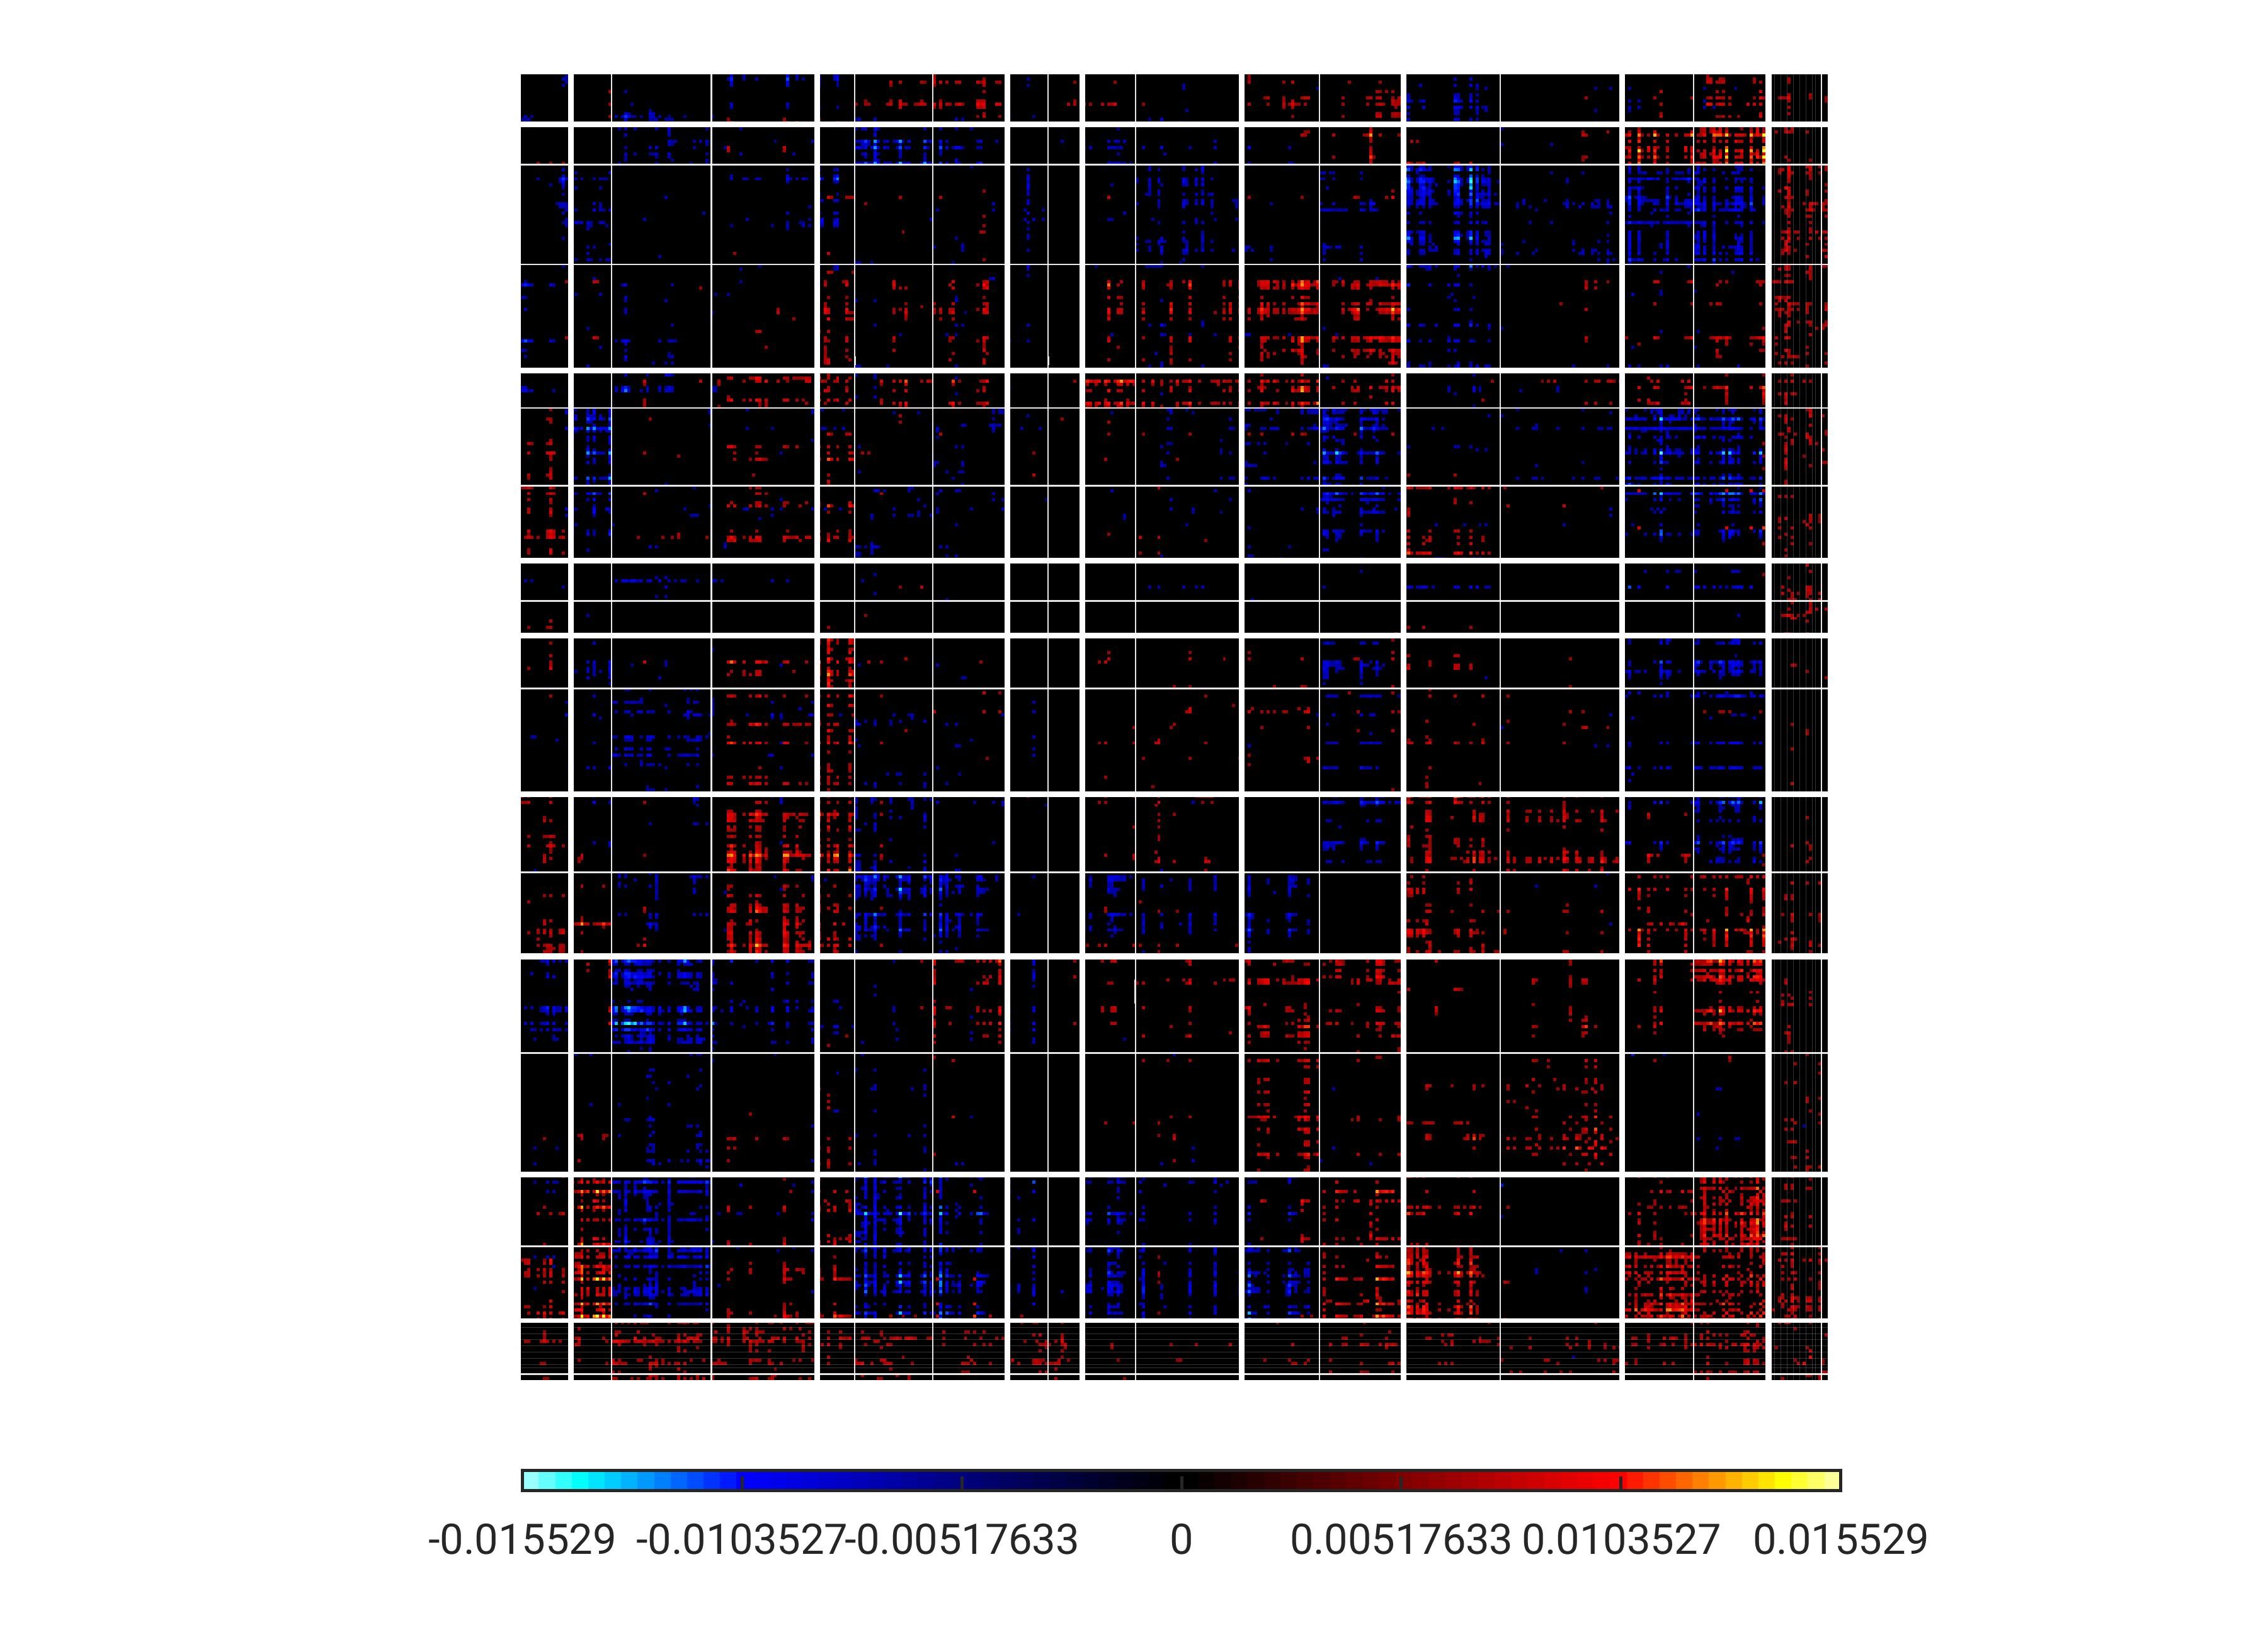
PC5
TempPar
Default
Control
Limbic
Sal/VentAttn
DorsAttn
SomMot
Visual
Subcort

Slide 17
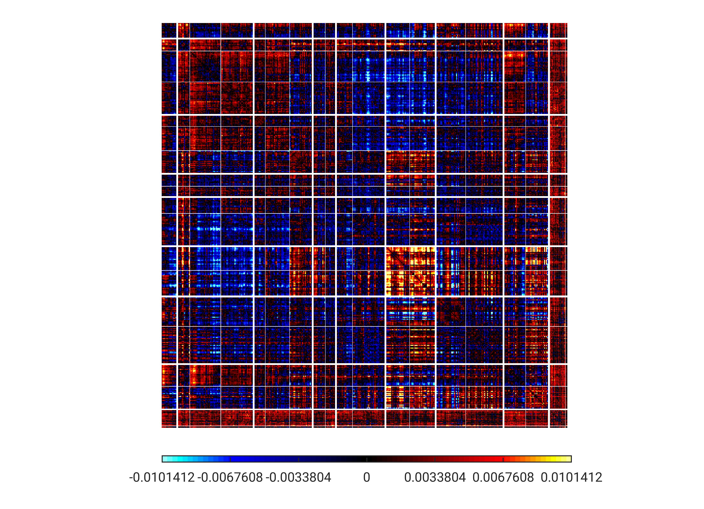
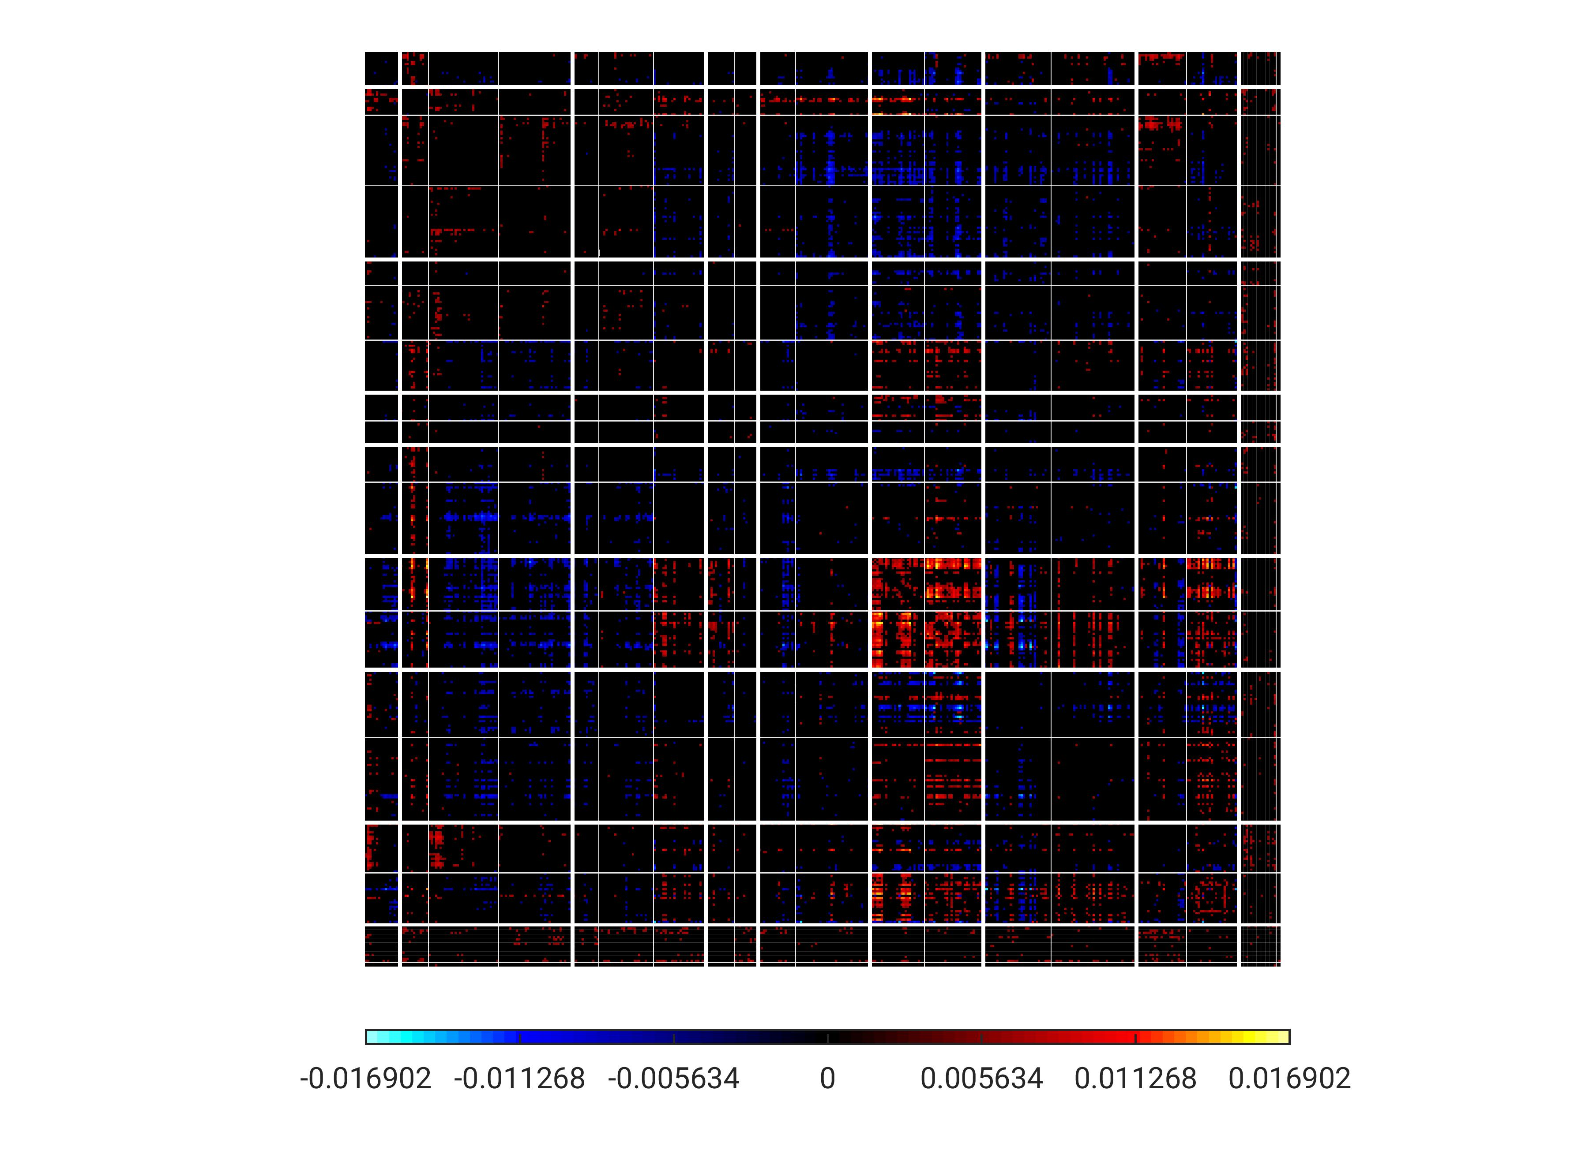
PC6
TempPar
Default
Control
Limbic
Sal/VentAttn
DorsAttn
SomMot
Visual
Subcort

Slide 18
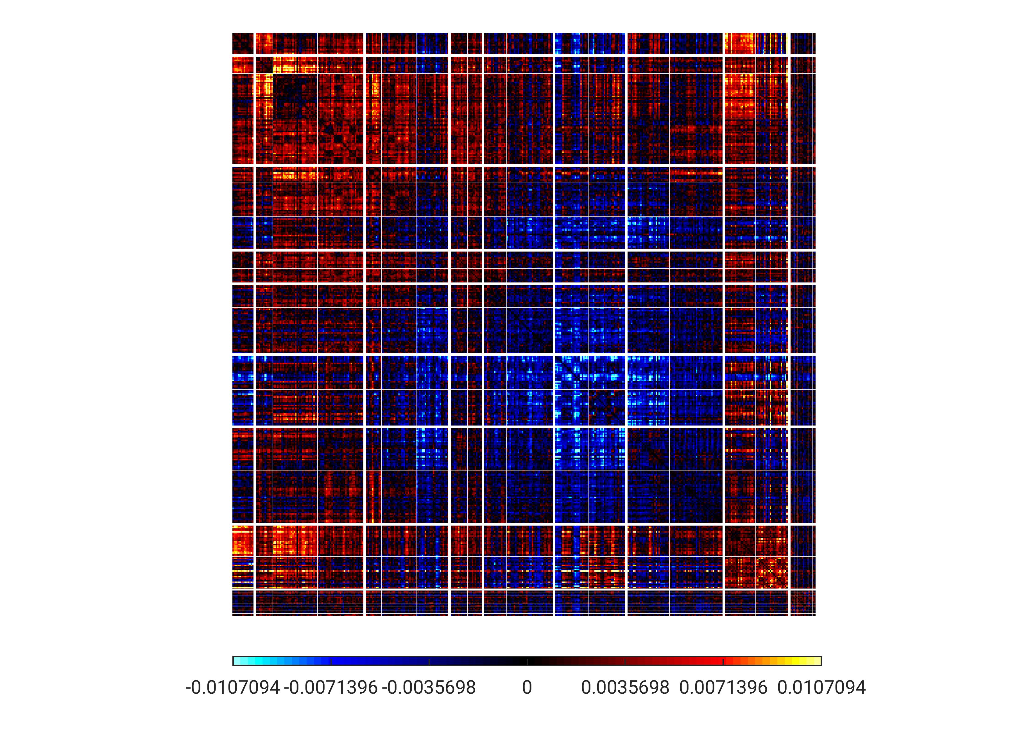
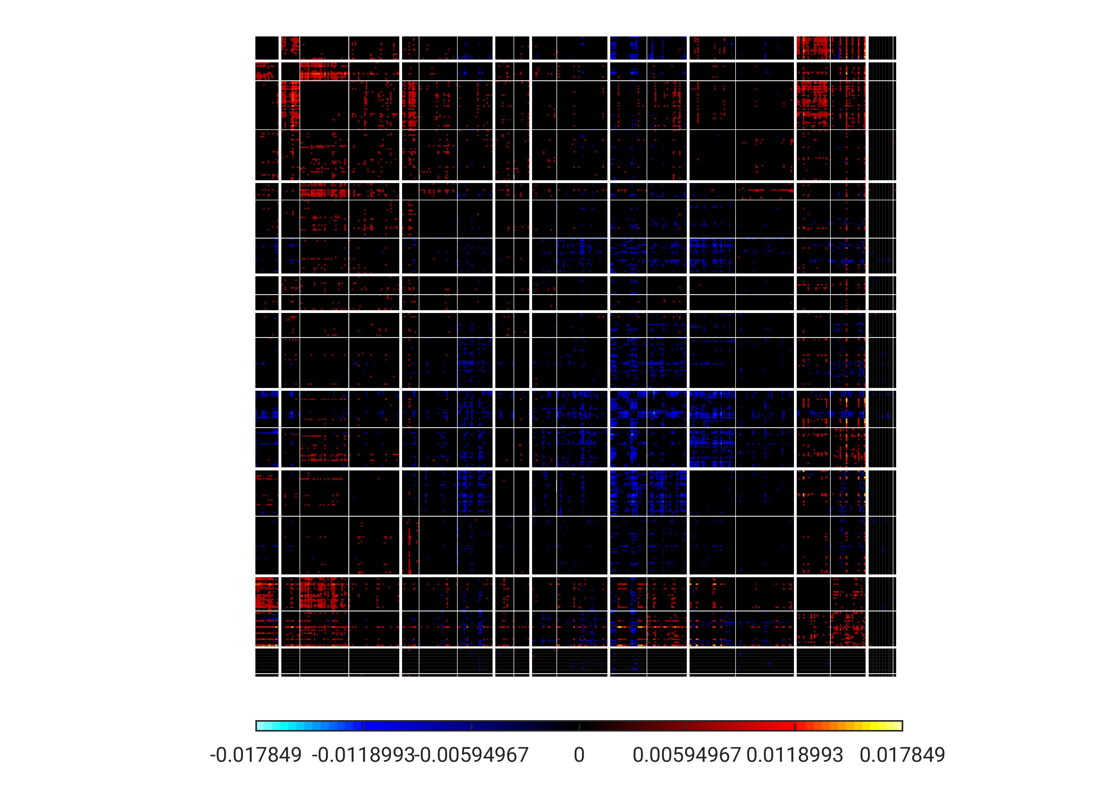
PC7
TempPar
Default
Control
Limbic
Sal/VentAttn
DorsAttn
SomMot
Visual
Subcort

Slide 19
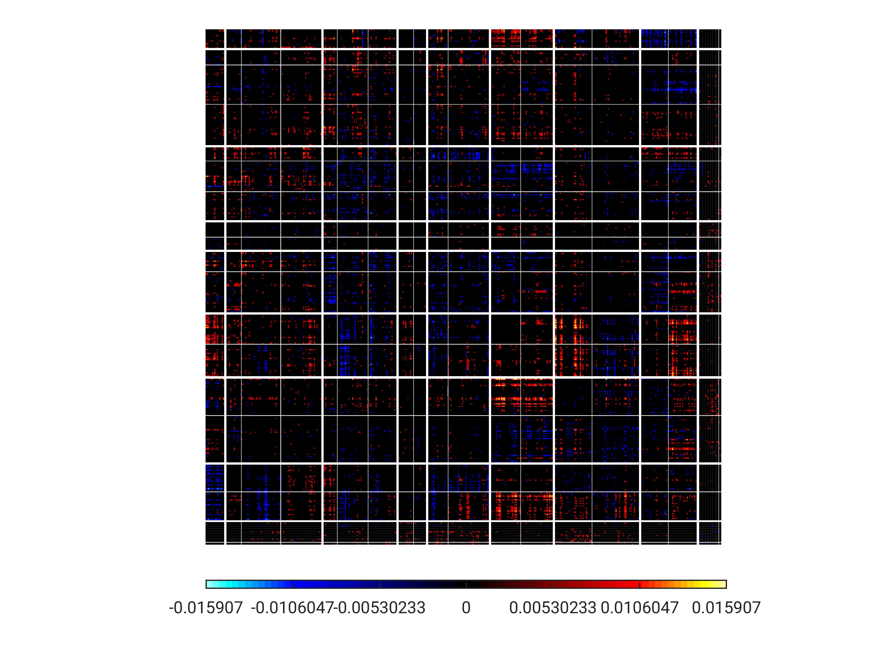
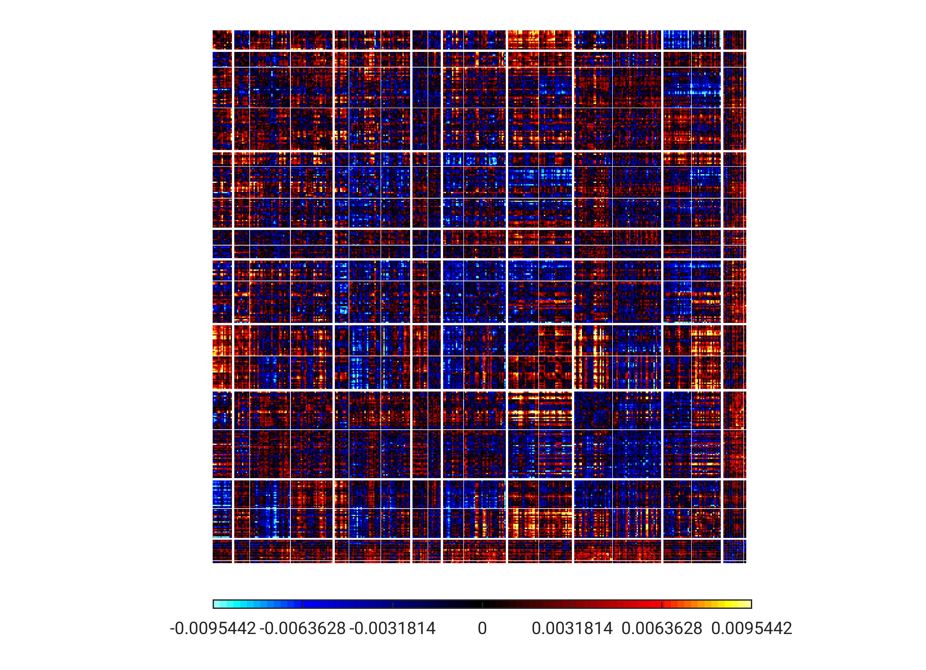
PC8
TempPar
Default
Control
Limbic
Sal/VentAttn
DorsAttn
SomMot
Visual
Subcort

Slide 20
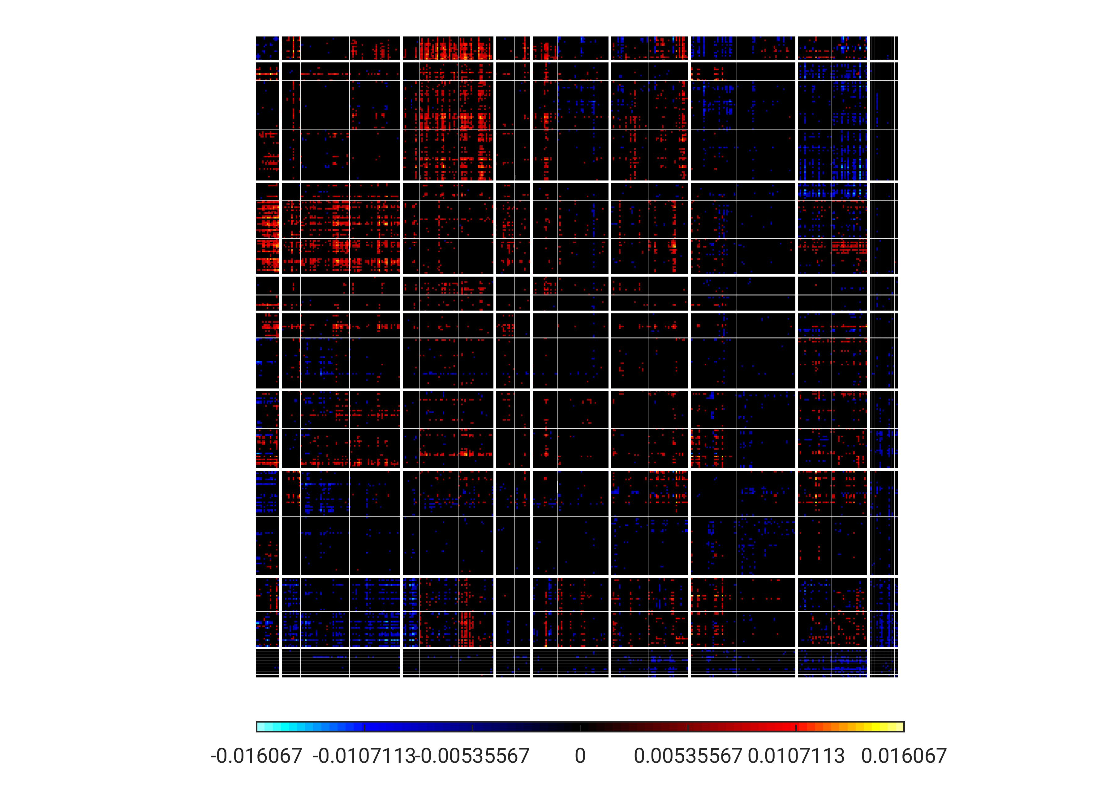
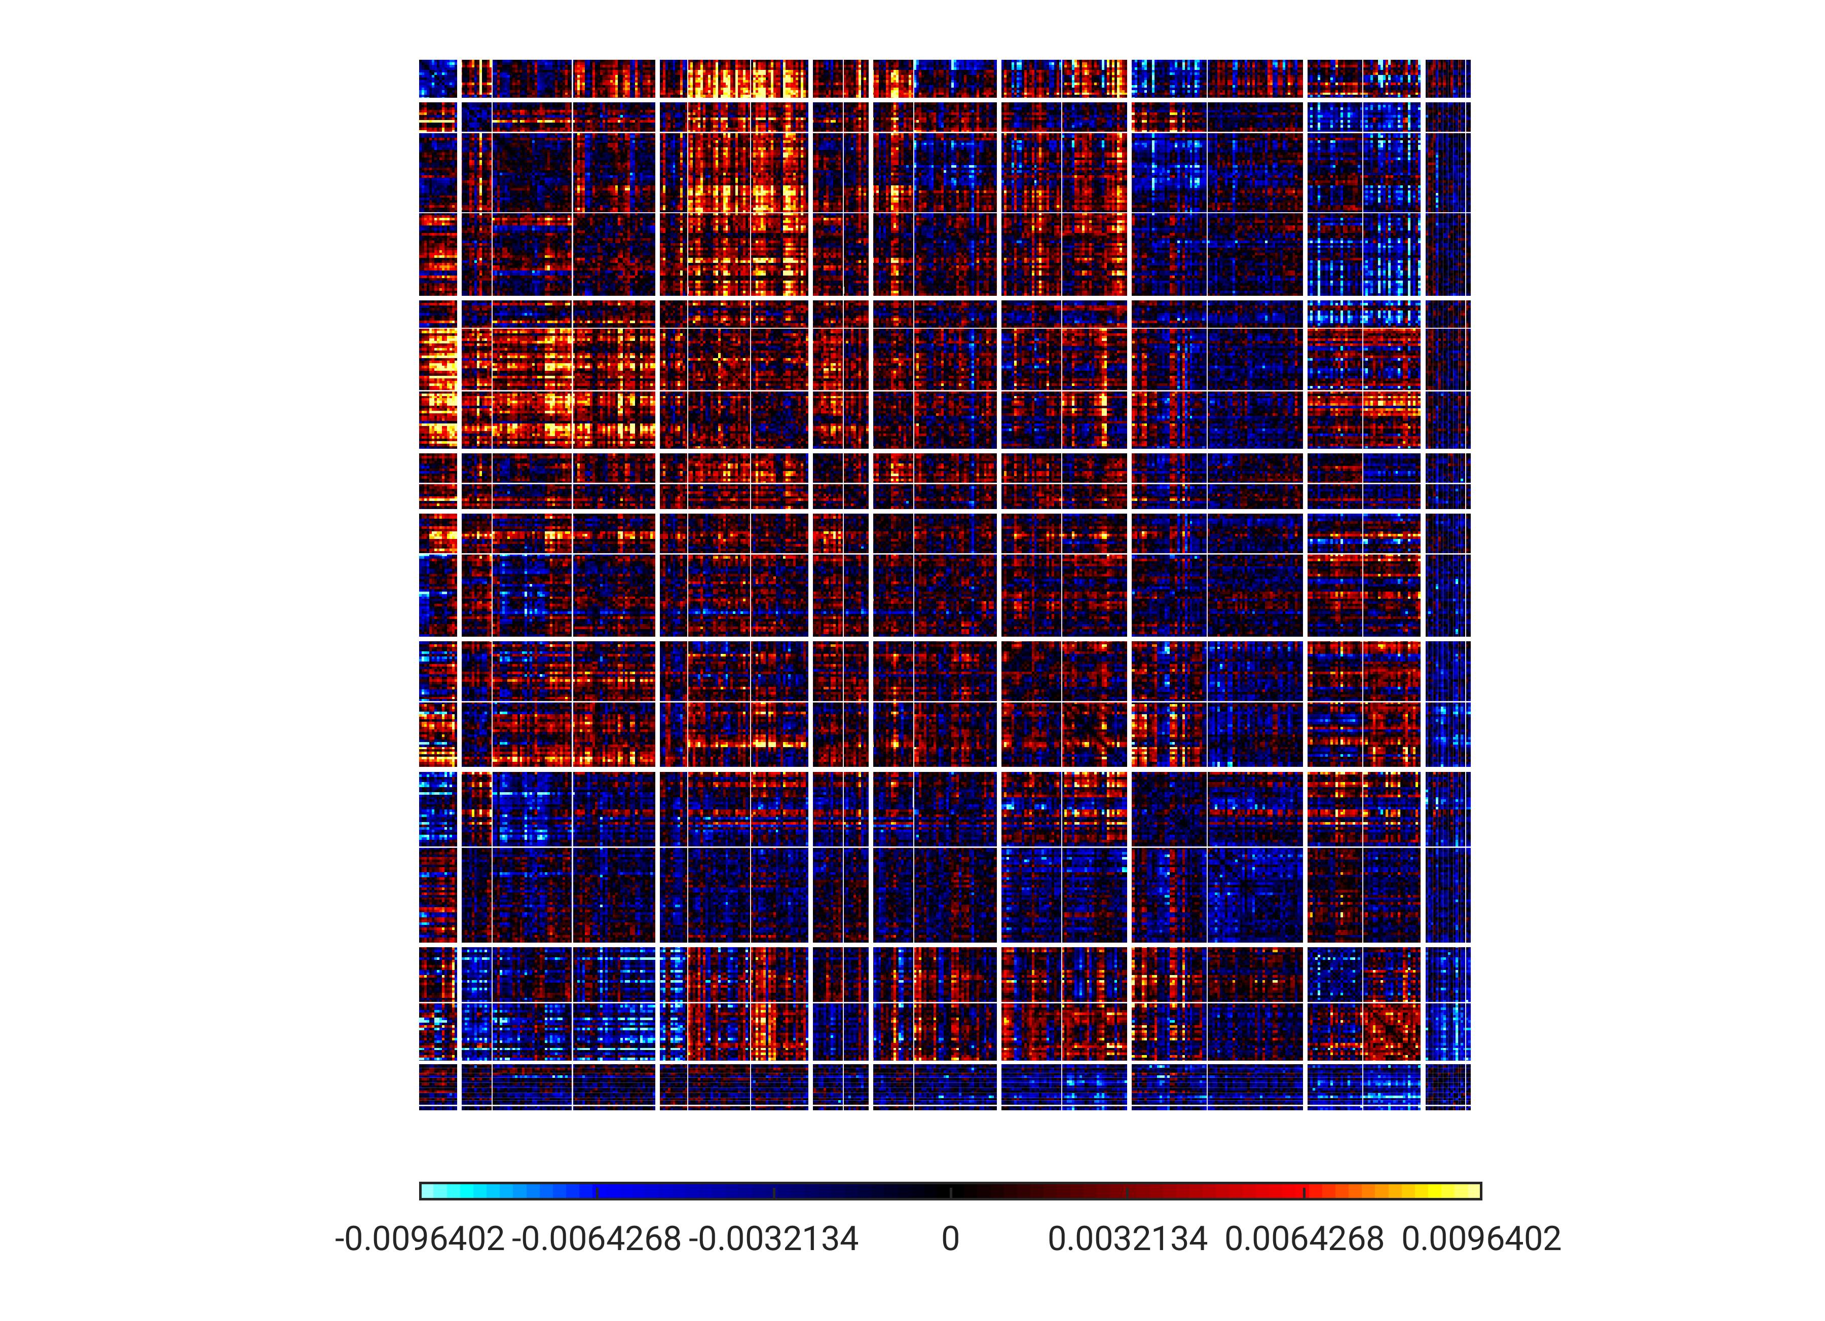
PC9
TempPar
Default
Control
Limbic
Sal/VentAttn
DorsAttn
SomMot
Visual
Subcort

Slide 21
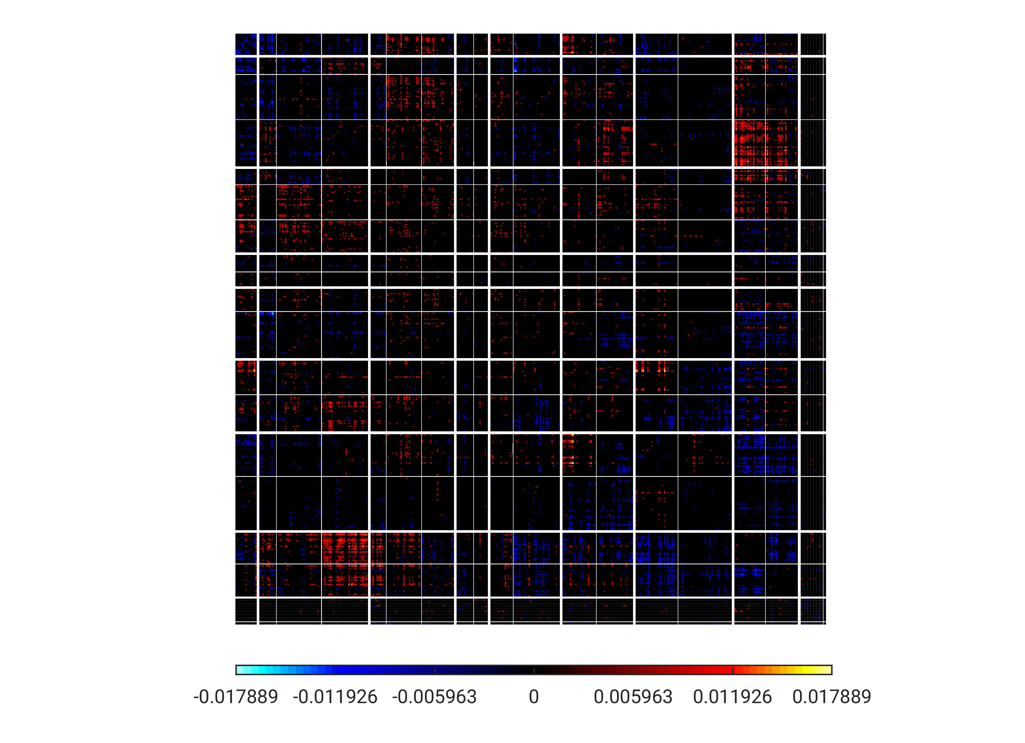
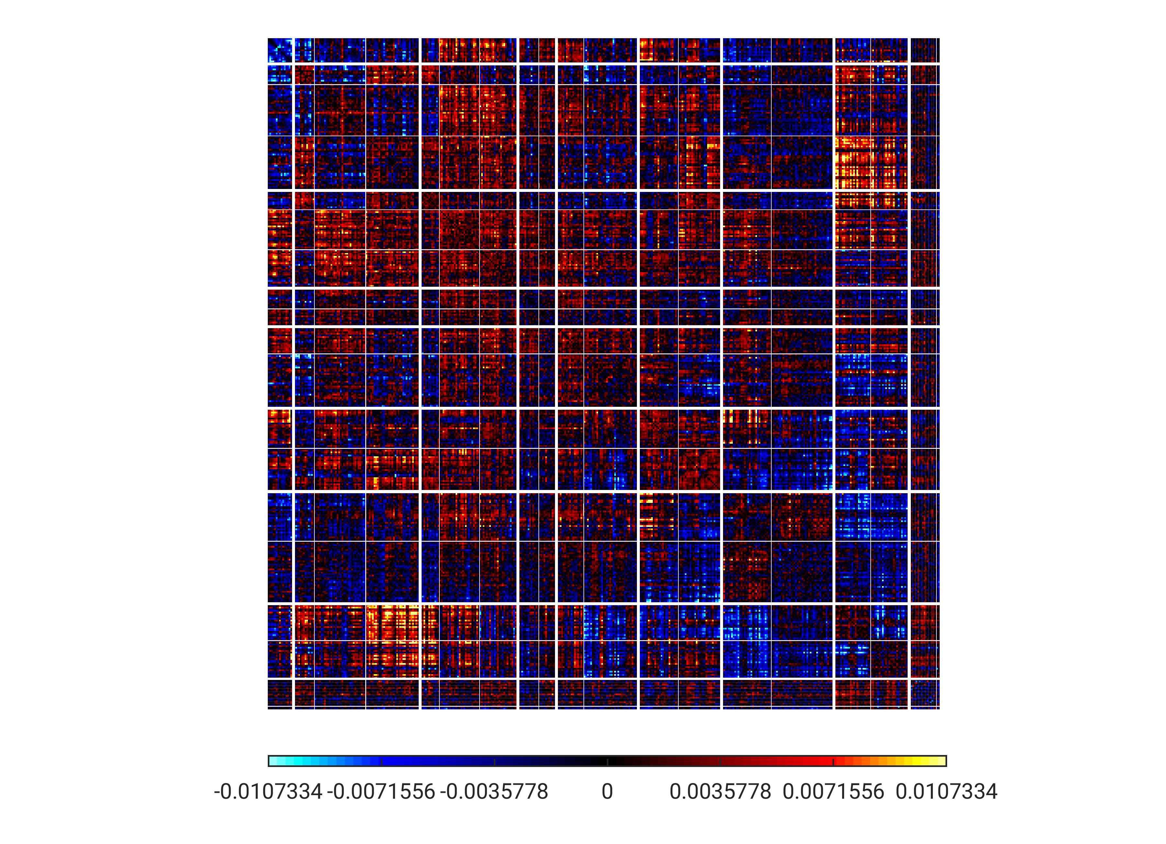
PC10
TempPar
Default
Control
Limbic
Sal/VentAttn
DorsAttn
SomMot
Visual
Subcort

Slide 22
Summary
It would seem that connectivity between brain regions tend to be better in capturing information of the movie scene being viewed, rather than just the pattern of activity.
The PC plots show that the connections between the Visual network and other networks, not just within the Visual network, tend to be more important in representing movie scenes.

